Slide 1

Customer Behavior Analysis
Domain: Data Analysis · Python · SQL · PostgreSQL · Power BI

Slide 2

Project Overview
A data-driven study of customer purchasing behavior, subscription patterns, and revenue trends — translating raw transaction data into actionable business insights.
Source
Focus
Real-world retail transaction data
Behavior, subscriptions, revenue
Output
Interactive Power BI dashboard

Slide 3
Project Objectives
Purchasing Behavior
Repeat Buyers
Subscription Patterns
Analyze what, when, and how customers buy
Identify and profile loyal returning customers
Study subscription impact on spending
Revenue by Age Group
Customer Preferences
Map purchase contribution across demographics
Understand category and product preferences

Slide 4
Tools & Technologies
Python
SQL
Data cleaning, transformation, and preprocessing pipelines
Complex queries for revenue, segment, and trend analysis
PostgreSQL
Power BI
Relational database for structured data storage and querying
Interactive dashboards and KPI visualizations

Slide 5
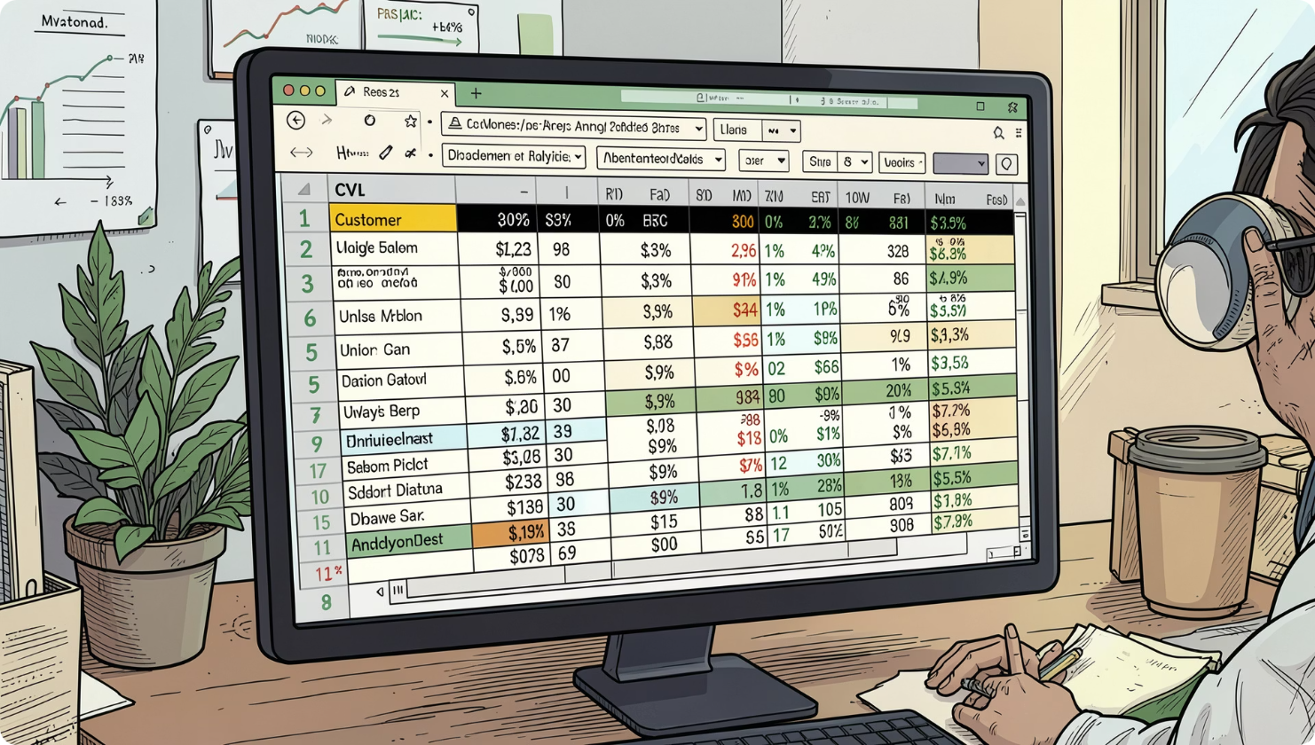
DATASET
Dataset Description
File: customer_shopping_behavior.csv
Source: Kaggle
Customer Profile
Customer ID, Age, Gender
Transaction Data
Category, Purchase Amount, Previous Purchases
Engagement
Subscription Status, Review Rating
Missing Data
37 missing values in Review Rating

Slide 6

Methodology
Data Collection
Data Cleaning
Database Connection
Dashboard Creation
SQL Analysis
End-to-end pipeline from raw data to interactive business intelligence dashboard.

Slide 7
Python Data Preprocessing
Handle Missing Values
1
Imputation and null removal
Standardize Columns
2
Consistent naming conventions
Create Age Groups
3
Segment by demographic cohort
Frequency Mapping
4
Categorical encoding for analysis
Load to PostgreSQL
5
Export cleaned data to database

Slide 8
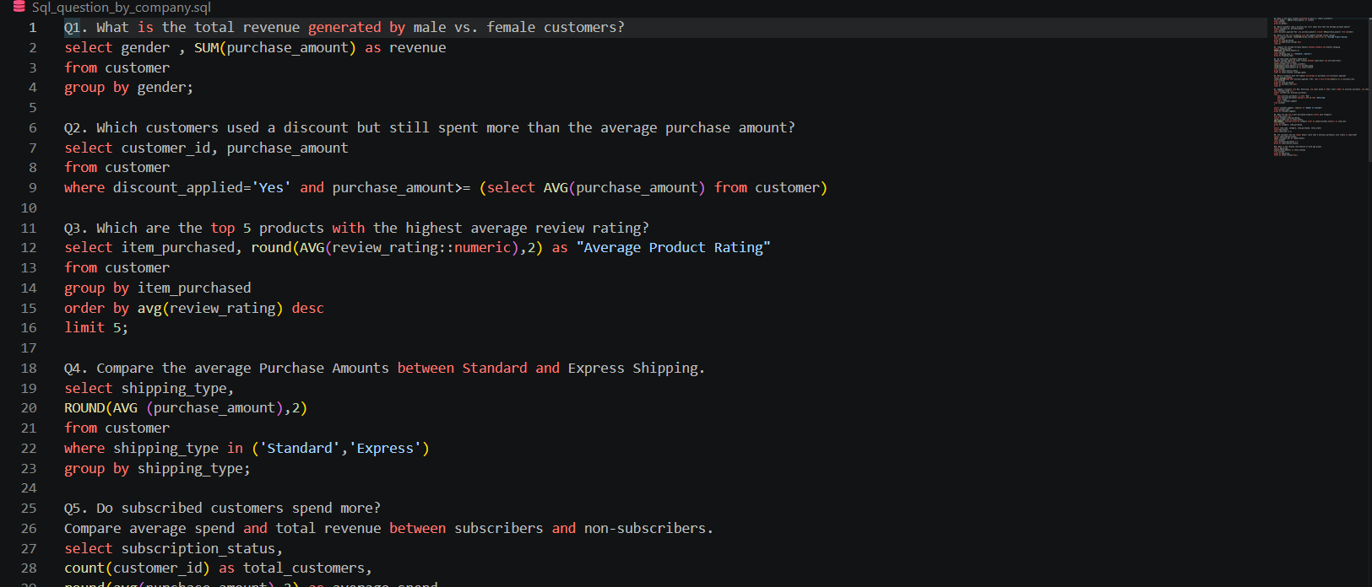
SQL Analysis
1
2
Revenue by Gender
Subscriber Spending
Compare spending across genders
Average spend: subscribers vs. non-subscribers
3
4
Repeat Buyer Analysis
Top Products by Category
Frequency and loyalty patterns
Rank categories by revenue contribution

Slide 9
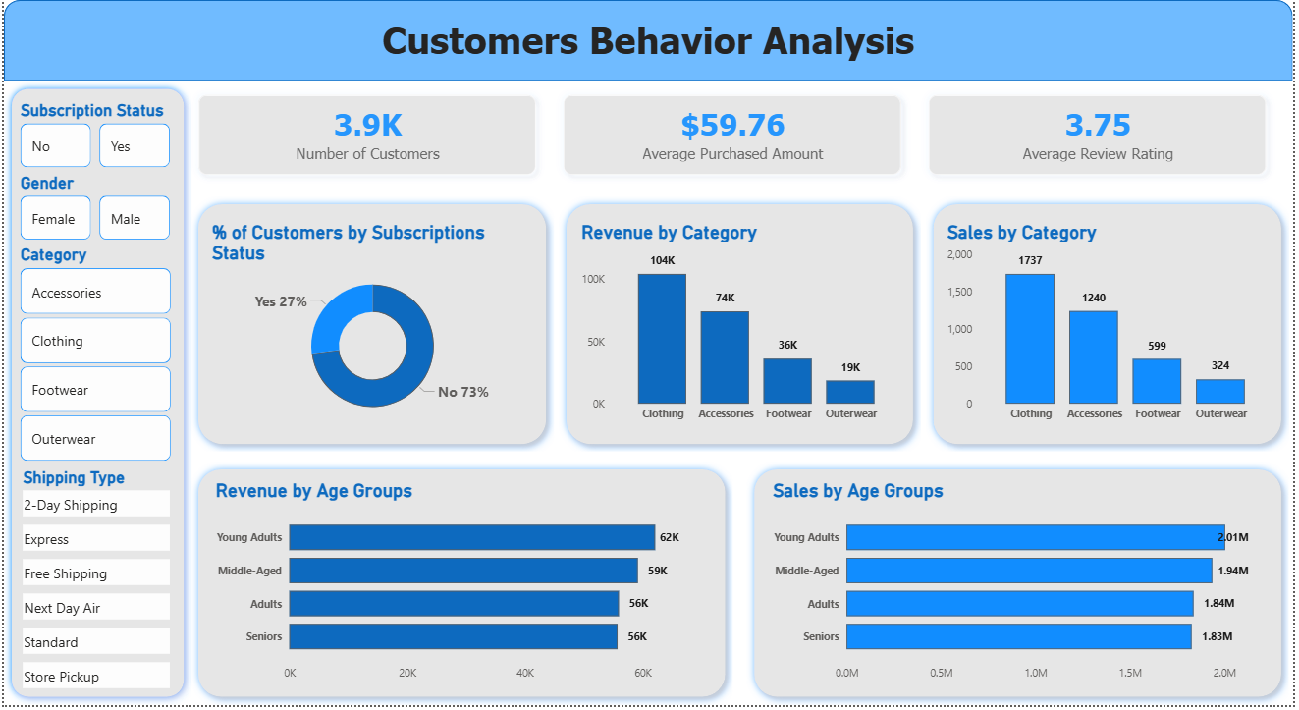
Power BI Dashboard
Revenue by Category
Clothing leads all segments
Subscription Distribution
Subscriber vs. non-subscriber split
Sales by Age Group
Young adults dominate purchases
KPI Metrics
Total revenue, avg order, repeat rate

Slide 10

Key Findings
👗 Clothing = Top Revenue
Highest-grossing category overall
💳 Subscribers Spend More
Higher average transaction value
🧑 Young Adults Lead
Strongest purchase volume by age group
🏷️ Discounts Drive Sales
Promotions significantly boost conversion

